Slide 1
IAEA’s LiveChart
D. Abriola
Nuclear Data Section
Department of Nuclear Sciences and Applications
20th NSDD Meeting, Kuwait, Jan. 2013

Slide 2
A Relational Database for Structure and Decay Data
Relational Database
All fields from
- Adopted levels & gamma
- Decay datasets
- etc..
More than 130 fields
A relational database enables
very powerful retrieval and presentation of data

Slide 3
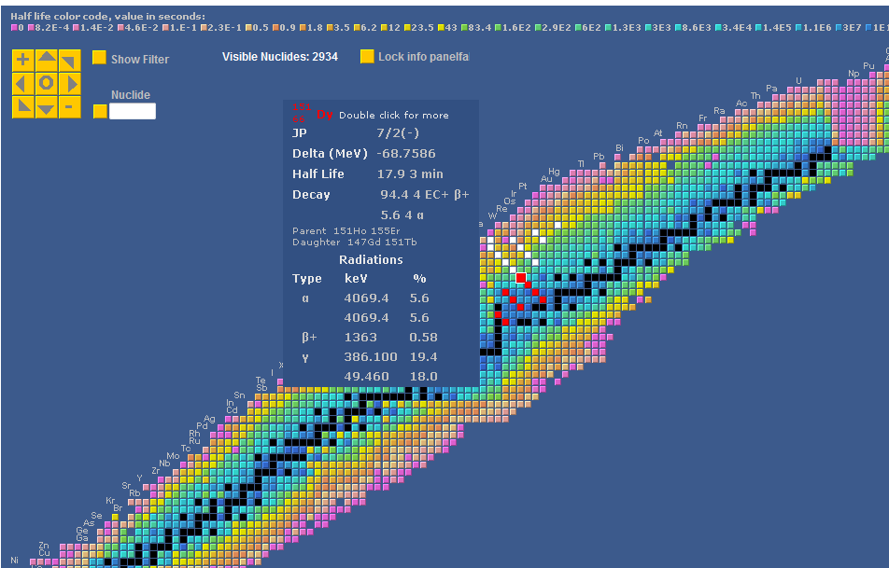
Livechart
nuclide data on
mouse-over
single selection
zooming and moving
parents – daughters chain (white - red)

Slide 4
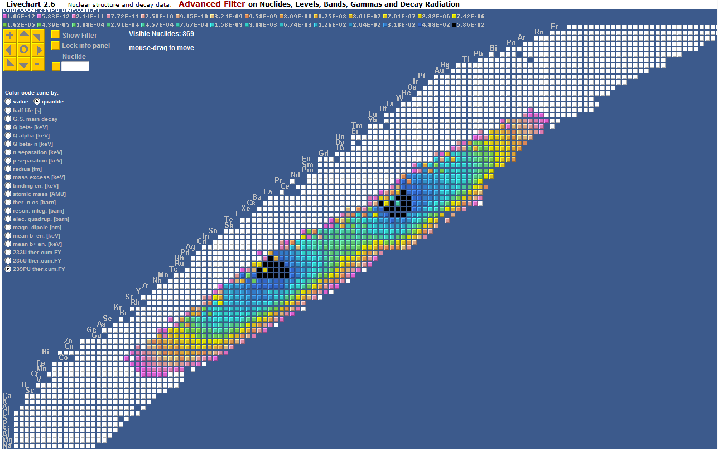
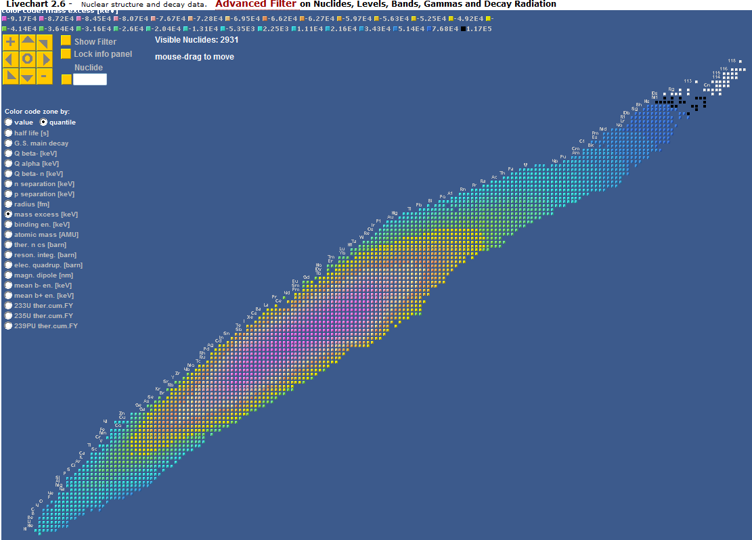
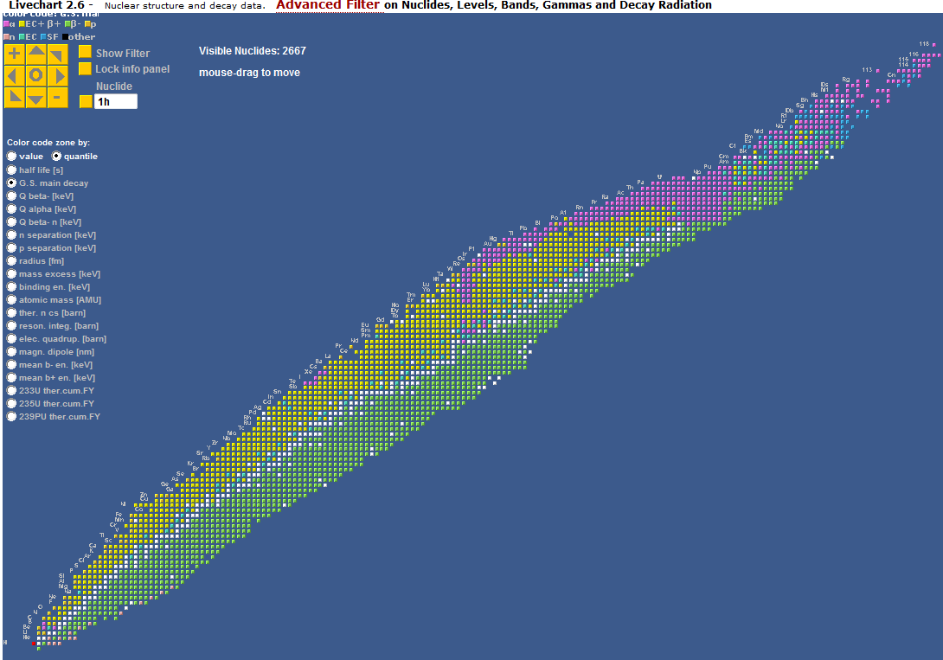
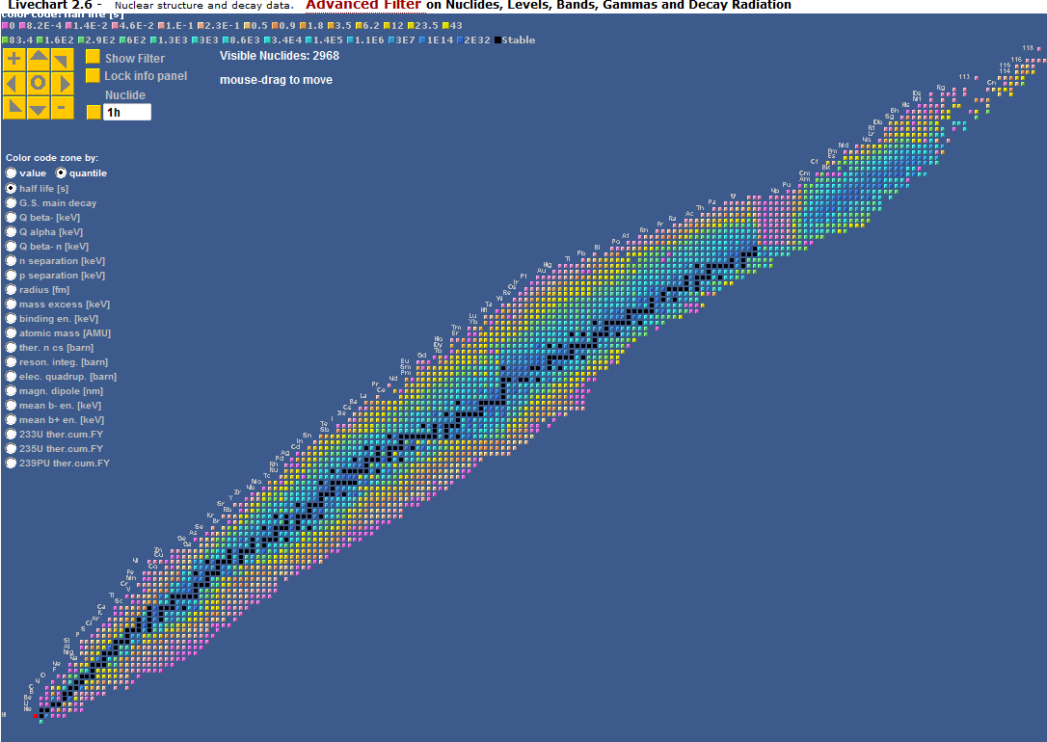
Color code examples
Fission Yields
Mass excess
Decay Mode
Half Life

Slide 5
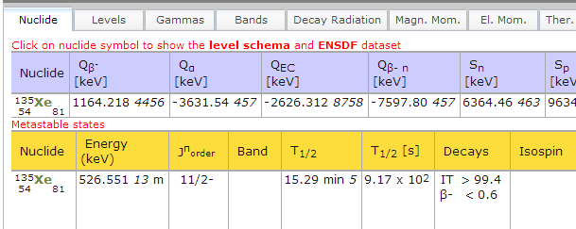
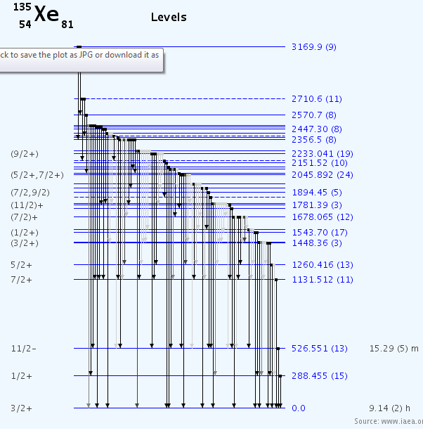
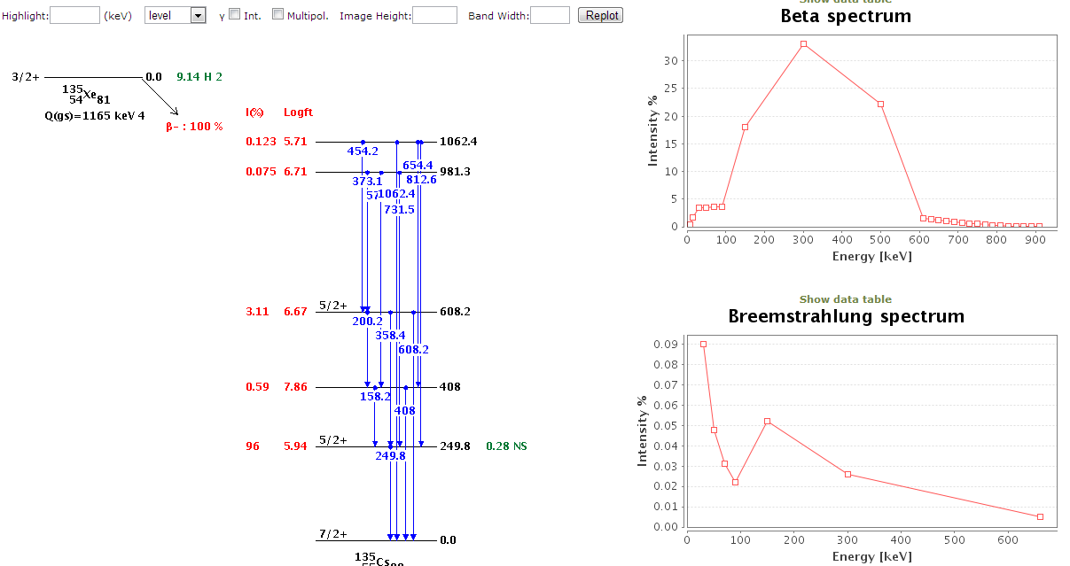
Nuclide data detail
Ground and Meta states summary
All ENSDF data on
Levels and bands
Gammas
Decay radiation
+
All AMDC data
Angeli Radii
Stone Nuclear Moments
Fission Yields
Thermal neutrons σ
Plot
Level schema and γ
Decay schema
Beta spectrum
Bremsstrahlung spectrum

Slide 6
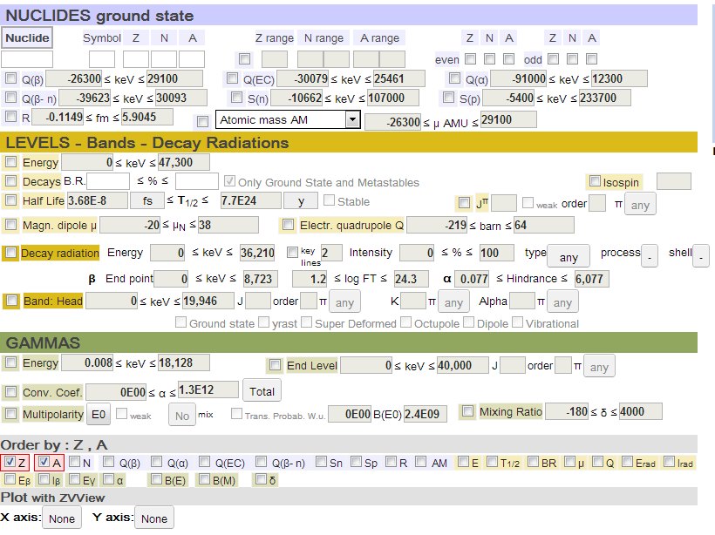
Query tool
Angeli and Audi data
decay datasets
bands
end level details
plotting

Slide 7
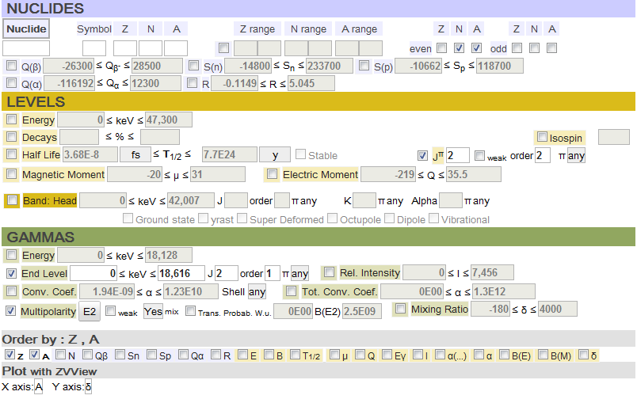
Plot example: A versus Mixing ratio of gamma transactions
from a level J 2` to a level J 2 in even-even nuclides
even - even
starting level J 2’
end level J 2
E2 mixed
plot
Notes:
This shows that one can put conditions on the gamma start level AND the end level

Slide 8
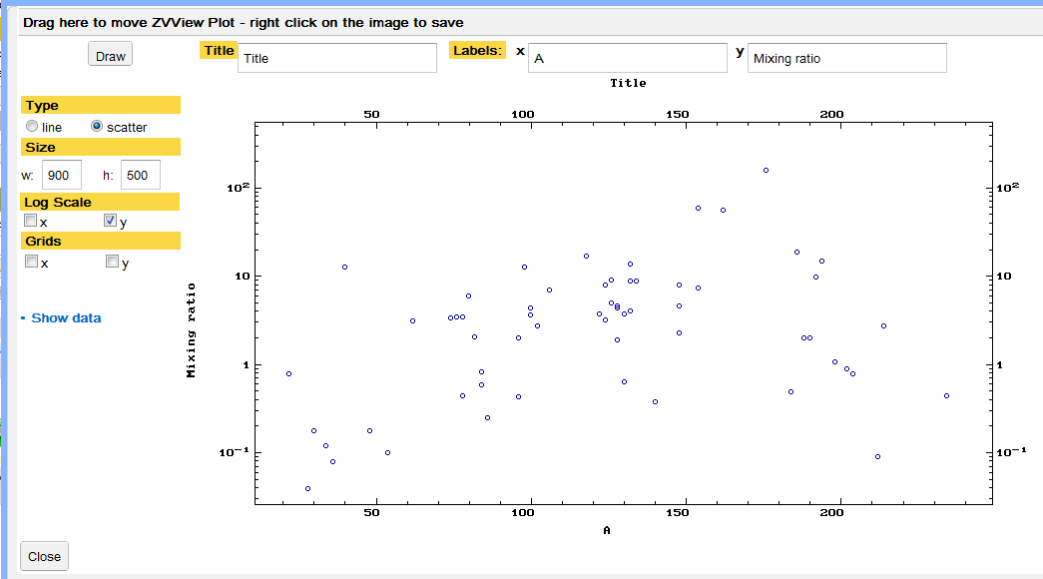
Plot A versus mixing of E2 mixed gamma transactions from a level J 2` to a level J 2 in even-even nuclides

Slide 10
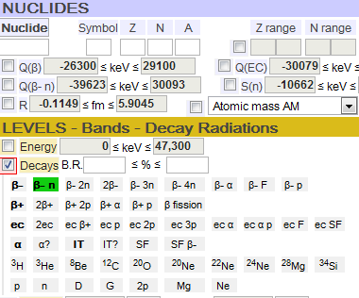
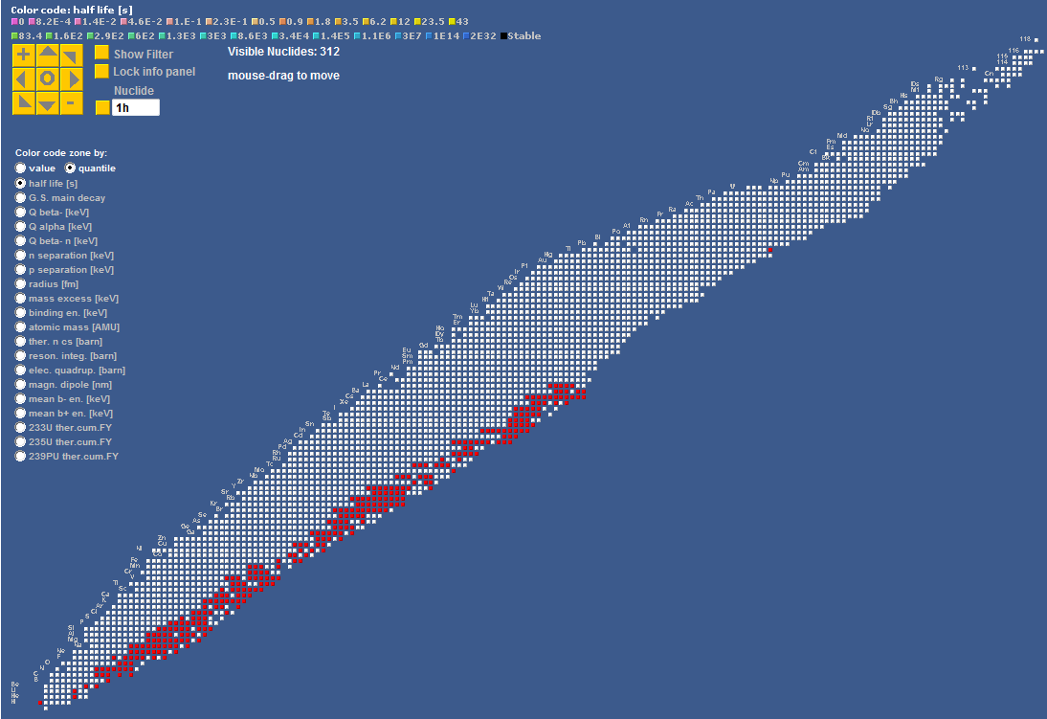
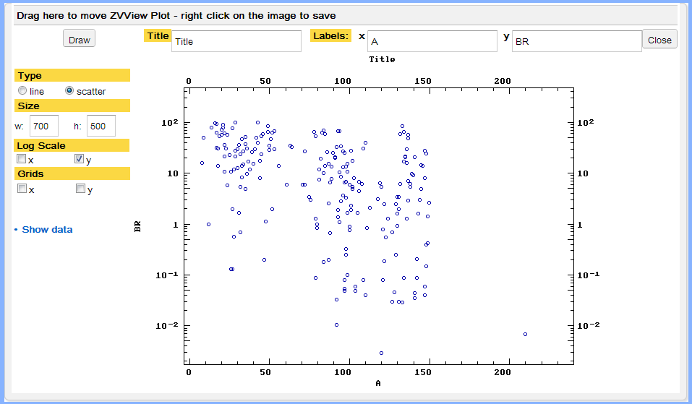
Select β- n decay and
plot A vs Pn
Plot panel shows
A vs Pn
Livechart shows the nuclides
Pn

Slide 11
Latest developments
ON THE TECHNOLOGY
- A Livechart version completely in HTML to avoid using Java Applets
ON THE SUBSTANCE
- Decay data querying and plotting
- Mass-chain representation

Slide 12
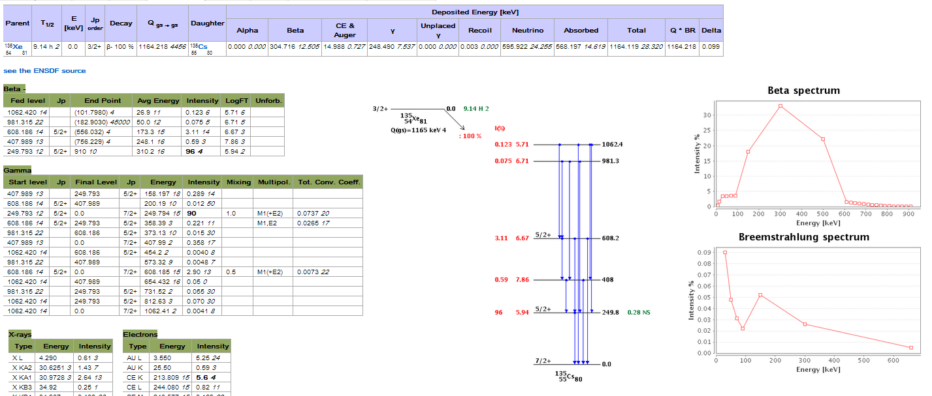
All ENSDF decay datasets parsed in a relational database.
Web-page display overview
Deposited energy, β and Bremstrahlung spectra
Schema plotting
Details for
β- , β+, EC, α, ϒ, delayed, electrons, X-ray

Slide 13
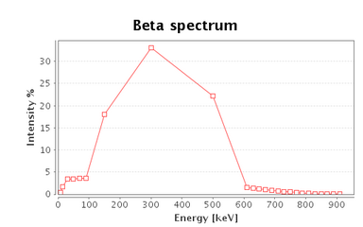
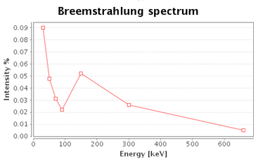
Detail of the decay web page content 1
Decay info - Q from AMDC 2011.
Link to the ENSDF source
Deposited energy,
Β, and bremstr.
from Radlist

Slide 14
Detail of the decay web page content 1
Decay info - Q from AMDC 2012.
Link to the ENSDF source
Deposited energy,
Β, and bremstr.
from Radlist

Slide 15
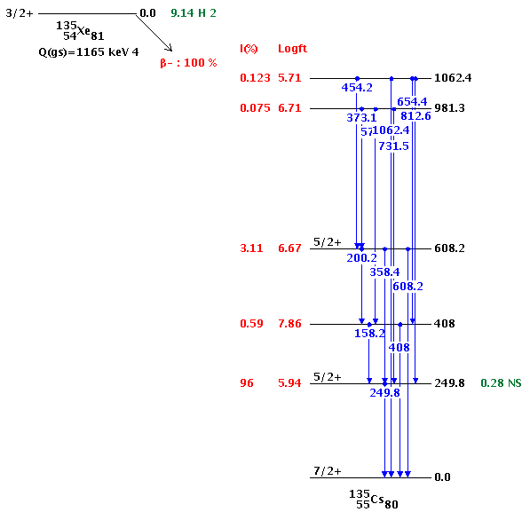
Detail of the decay web page content 2
Decay schema plot
Software by McMaster University-Nuclear Data Project

Slide 16
Detail of the decay web page content 3
29MG 30NA B-N DECAY 1989BA07 ENSDF 200910
29MG C Other: 1984La03
29MG C Other: 1984La03
29MG H TYP=FUL$AUT=M.S. BASUNIA$CUT=30-JUN-2009$CIT=ENSDF$
29MG H TYP=FUL$AUT=P.M. ENDT, R.B. FIRESTONE$CIT=NP A633, 1 (1998)$
29MG2 H CUT=1-Jan-1999$
29MG C 1989BA07: 30NA was produced bombarding a uranium carbide target with
29MG2C 600 MeV protons from the ^CERN synchrocyclotron, mass separated in the
29MG3C ^ISOLDE facility; NE213 scitillator, 2 HPGe detectors and one
29MG4C neutron detector; Measured: EG, RI, GG COIN, G-N COIN.
29MG N 0.42 3 0.30 4 0.30 4
29MG CN NR$NR from 1989Ba07.
29MG PN 3
30NA P 0 2+ 48 MS 2 10910 30
29MG L 0 3/2+
29MG CL J$From adopted levels
29MG DN 71 2.6 4 6515
29MG DN 115 2.4 4 6561
29MG DN 180 40 0.2 1 6632
29MG DN 242 0.6 1 6692
29MG DN 375 1.8 3 6830
29MG DN 847 7319
29MG DN 2270 90 0.5 1 8792
Full detail for
each radiation type.
106IN L 1925.3 151+
106IN E 2 0.5 1.2 2
106INS E EAV=112 23$CK=0.25 25$
38AR L 3810.19 6 3-
38AR B 1110 10 33.1 8 4.903 11
38ARS B EAV=420.01 14
38AR B 0.02 LT 9.6 GT 1U?
38ARS B EAV=638.97 14

Slide 17
135CS L 407.989 13
135CS B 0.59 3 7.86 3
135CSS B EAV=248.1 16
135CS G 158.197 18 0.321 11 C
135CS G 407.99 2 0.398 13
Atomic radiation from RADLST
234TH L 0.0 0+
234TH A 4198 3 79.0 27 1.0
234TH CA IA 77% 4 was measured by 1959Ko58.

Slide 18
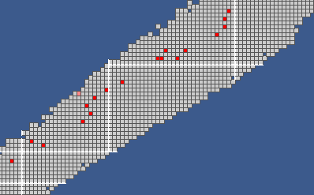
Examples of queries
Nuclear medicine: e+ emissions with filter on half-life, energy, and intensity
Visualisation on Livechart

Slide 19
Gamma spectroscopy : peak identification
Filter on key-lines
Delayed particles
Neutrons in β- 2n decays

Slide 20
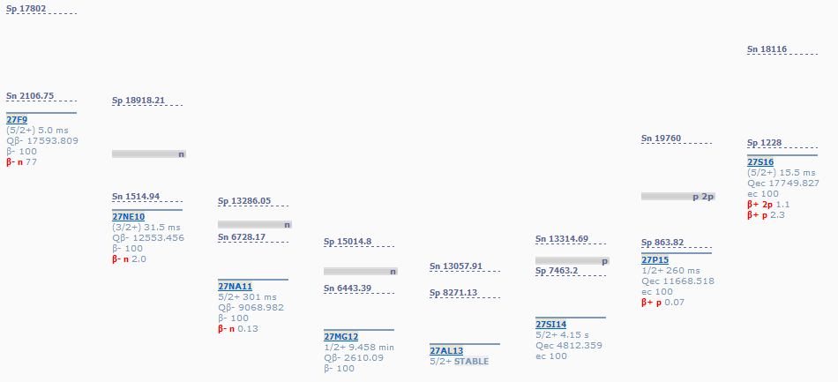
All Mass Chains in one web-page
With separations energies, intermediate states, and data for metastable and ground states:
Jp, decays, half-lives and Q-values.
Clicking on a nuclide opens the a detail page

Slide 21
Work in progress
Parsing XUNDL into the database
SUGGESTIONS ARE WELCOMED !

Slide 23
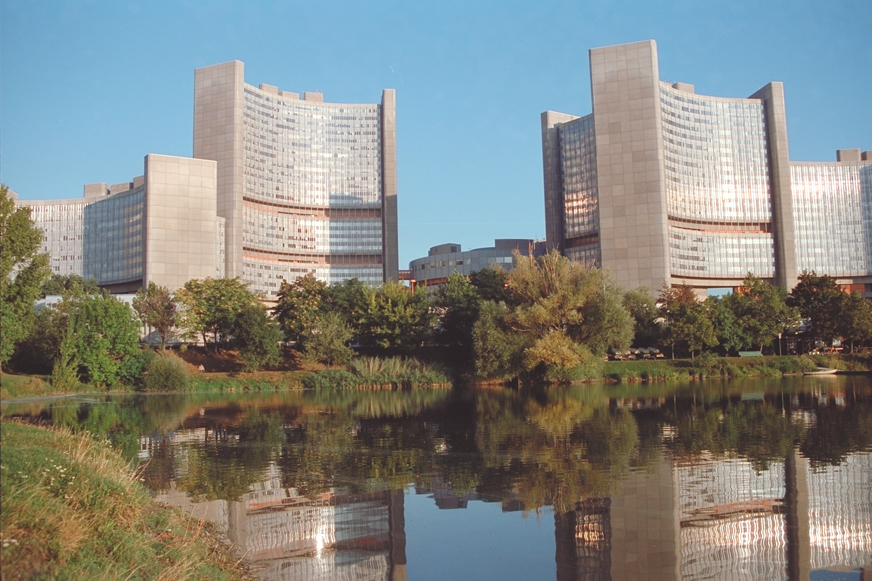
Thank you

